Slide 1



Hotel Management System
This presentation outlines the design and analysis of algorithms used in a hotel management system project. The project aims to streamline hotel operations, enhance guest services, and automate various tasks. We will explore the key modules and algorithms employed to achieve these objectives.
Hyndhavi Chakka (AP23110010993)
Lokeshwar Madhira (AP23110010722)
Kaushik Mosa (AP23110010965)
Pravallika Attipatla (AP23110010520)
Notes:
1

Slide 2

Project Overview
Room Booking and Reservation
Check-In/Check-Out
Billing and Payment
Manages guest arrivals/departures, updates room status, and maintains guest records.
Calculates room rates, service charges, taxes, and manages invoices and payment processing.
This module handles room reservations, checks availability, and organizes room options for guests.
Notes:
2

Slide 3

Staff Management
This module manages staff schedules, tracks attendance, and assigns tasks to ensure smooth operations.
1
Greedy Algorithm
2
Time Complexity
Optimizes scheduling by prioritizing task assignments based on availability, skill, or workload.
O(n log n) for sorting by priority, supporting efficient scheduling and task allocation.
Notes:
3

Slide 4




Event and Conference Management
This module manages event bookings for conference rooms and banquet halls, ensuring no scheduling conflicts.
Binary Search
Checks availability if event spaces are sorted.
Merge Sort
Arranges bookings by date and time to prevent double-booking.
Time Complexity
Binary Search: O(log n), effective for sorted lists. Merge Sort: O(n log n), efficient for organizing event times and avoiding overlap.
Notes:
4

Slide 5

Feedback and Review
This module collects and analyzes guest feedback to assess service quality and pinpoint areas for improvement.
Algorithm
Description
Time Complexity
Sentiment Analysis
Keyword-based approach for identifying positive or negative feedback trends.
O(n)
Notes:
5

Slide 6

Room Booking and Reservation Module
This module manages room reservations, checks availability, and organizes room options for guests.
1
Linear Search
2
Sorting
Finds available rooms by searching the room list.
Sorts rooms by criteria such as price or type.
3
Time Complexity
Linear Search: Time complexity of O(n), efficient for moderate room lists. Bubble Sort: Complexity of O(n²); useful for smaller room inventories to provide organized room choices.
Notes:
6

Slide 7



Check-In/Check-Out Module
Manages guest arrivals/departures, updates room status, and maintains guest records.
Queue
Time Complexity
Implements First-In-First-Out (FIFO) order for check-ins/check-outs, especially useful during busy hours.
Queue Operations (Enqueue/Dequeue): O(1) complexity, enabling quick processing of guests.
Notes:
7

Slide 8
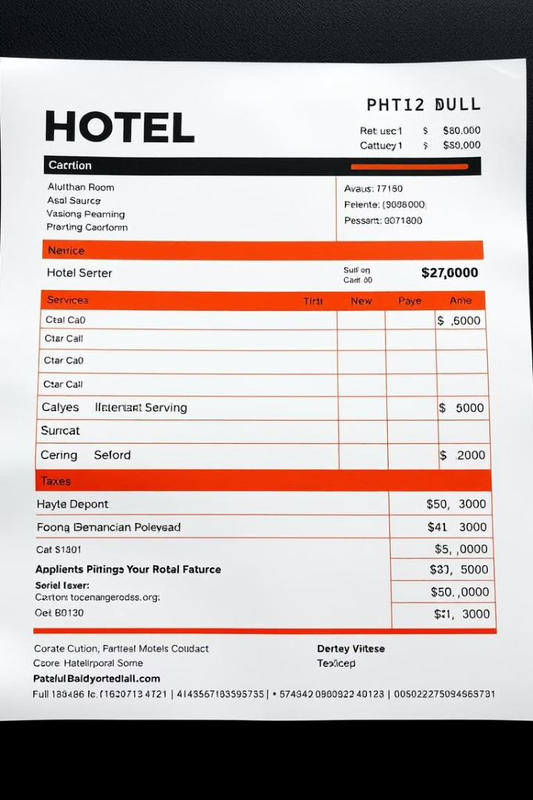
Billing and Payment Module
Calculates room rates, service charges, taxes, and manages invoices and payment processing.
Simple Calculation
Linear Search
Computes total charges, including taxes and services.
Finds specific services or charges for updates in invoices.
Time Complexity
Simple Calculation: O(1) complexity, ensuring fast billing. Linear Search: O(n) complexity, adequate for handling billing tasks.
Notes:
8

Slide 9
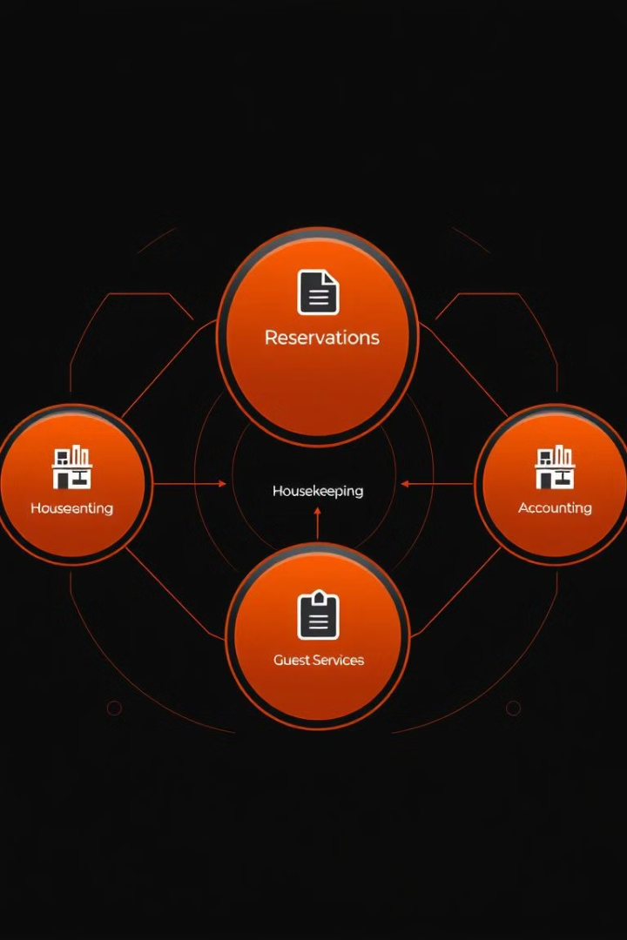
Summary
The hotel management system utilizes a combination of algorithms to streamline operations and enhance guest experiences. These algorithms include Linear Search, Queue, Simple Calculations, Greedy Algorithm, Binary Search, Sorting, and Sentiment Analysis. Each algorithm plays a crucial role in optimizing specific tasks, ensuring efficiency and effectiveness throughout the system.
Notes:
9

